Slide 1

THE NUGGETEER
November 2021
Vol.1 No.11
A Message from the President
Tim’s Tidbits
Hello, members and Prospectors. When in and around old mine sites and diggings, be mindful to go through the tailings and see what you can find.
Tim Pitney
President COSGPAA
Web address: http://cosgpaa.org
Facebook address closed https://www.facebook.com/groups/733783243720768/members/
Facebook address open https://www.facebook.com/cosgpaa
Tonight’s precious metals spot prices per Troy ounce
Year | Gold | Silver | Platinum | Palladium | Rhodium
2020 | $1,910.65 | $24.03 | $882.25 | $2314.10 | $13,600.00
2021 | $1,783.07 | $23.67 | $1.054.57 | $2,052.62 | $13,250.00

Slide 2

GPAA
COLORADO SPRINGS CHAPTER
GPAA OFFICERS Colorado Springs Chapter
President Tim Pitney
Vice President Joel Swisher 719-622-8693 joelswisher1@gmail.com
Treasurer Alton Oakes 719-439-3590 aoakessprint1@earthlink.net
Secretary Pat Oakes 719-339-0486 patoakes@centurylink.net
Claims Chairman Alton Oakes 719-439-3590. aoakessprint1@earthlink.net
Nuggeteer Editor Del Cox 719-591-1282 coxd@mac.com
Outings Chairman Justin Harmon 719 287-8149‬ hardtoflush79@gmail.com
Webmaster Paul Covington 719-310-7542 Paul@covingtoncomputers.com
Facebook editor Cindy Swisher 719-661-7542 cslactrn@gmail.com
Hospitality Committee Position Open
Do you want to join GPAA? You can see David Vigil at Sunny Mountain Prospectors located at:3007 North El Paso Street, Colorado Springs CO 80907
Renewals, multi-year discounts and life memberships available on-line at www.Goldprospectors.org , or call 800-551-9707 , and Please mention that you want to be part of the COLORADO SPRINGS CHAPTER.

Slide 3
MEETING MINUTES
November 3, 2021
Attendees: 19 in person; 138 by e-mail
The meeting was called to order at 7:00 pm by Chapter President Tim Pitney and began with the Pledge of Allegiance to the Flag. Tim welcomed everyone to the meeting and talked about the outing on Oct 30th to the GPAA Railroad Bridge Claim. The weather was great, and 14 members participated. Tim related a phone conversation he had with GPAA Membership where he learned that his Lifetime Membership had been suspended because he did not have an e-mail address or a current driver’s license on file. GPAA said they were updating their records to delete inactive memberships. Two other life members at the meeting reported similar suspensions. All were resolved when the members provided a copy of a current driver’s license. All chapter members with a Lifetime Membership more than a year old should contact GPAA to update their file. Call GPAA Member Relations Specialist Anne Tolleson at 800-551-9707 x117.
Treasurer Alton Oakes gave a financial report and detailed recent purchases using the Chapter’s Member Points Program. Due to a significant increase in catering costs, the Chapter Christmas Party this year will NOT be a catered event. As reported in last month’s Nuggeteer the December meeting and Christmas Party will be held together on Saturday, December 4th , from 1 – 5 pm. The location will be at Daniel’s Tacos, 6815 Space Village Avenue, Colorado Springs, CO 80915. Meeting setup begins at 12:30, with the meeting running from 1:00 to 2:00 pm; with dinner and the party immediately following. Please order your preference from the restaurant’s full menu. When you sign-in at the meeting, you will receive a coupon to present when placing your food and drink order. The Chapter will be paying for the meal and gratuity. Except for tickets for the Christmas drawing, the Chapter store will be closed. Entertainment includes:

Slide 4
MEETING MINUTES
November 3, 2021, Continued
White Elephant Exchange. If you want to participate, please bring a wrapped item, and tag it “white elephant”. The item can be a re-gift, an item your already own that someone else can treasure for a while, something funny, something weird, or something nice.
Member to Member Gift Exchange. If you want to participate, please bring a wrapped item, and label it “Gift Exchange Man” or “Gift Exchange Woman”. Usually, a man will bring gift for a man and a woman will brings a gift for a woman. If an odd number of members participate, you may end up with your own gift – so bring something you wouldn’t mind taking back home with you. Please limit purchases to $20.
Salvation Army Angel Tree Gift Donation. If you wish to participate, please bring a new, unwrapped toy to donate. If you would prefer to purchase a toy through a gift registry, visit: Fountain Valley Corps (salvationarmy.org) and select the “Walmart Gift Registry”, in the center of the page. If you have questions, please contact the Fountain Valley Salvation Army at 719-382-1182.
Christmas Party RSVP. If you were not able to attend the November meeting to sign up for the Christmas Party, please RSVP to Alton Oakes at 719-439-3590, by Friday, November 26th.
The liability insurance policy discussed at the October meeting has been obtained and given to the Salvation Army along with a current rental agreement. Alternate meeting locations reviewed by the Chapter Board were discussed, and the membership voted to move our meetings to VFW Post 3917 in Security, effective with the January 5th, 2022, meeting. After the vote, a member suggested another possible venue, a new restaurant with meeting rooms in the Satellite Hotel at Airport and Academy in Colorado Springs. Chapter Board members will inspect the restaurant and report their recommendations at the December 4th meeting.

Slide 5
Minutes Continued November 3, 2021
VP Joel Swisher opened the floor to nominations for the 2021 Chapter Board of Directors. The incumbents in the positions of President, VP, Secretary and Treasurer were nominated and consented to serve another year. Member Loraine Sirois was nominated and agreed to serve in the newly required position of Membership Chairperson. Final nominations and the election will be held at the December 4th meeting.
Tim spoke with Assayer Richard Sweeney about a presentation for the Chapter and learned that Mr Sweeney was researching a dowsing class for the Western Museum of Mining and Industry (WMMI). If there was adequate interest, a hands-on component would have students dowse for precious metals in the field adjacent to the museum. Mr Sweeney would be donating silver coins as targets. Tim volunteered as an assistant instructor. In support of the training, the membership voted to donate one silver and 5 copper, one ounce prospector coins as additional targets.
After the door prize drawing, the meeting was adjourned at 8:55 pm. Thanks to members Phyllis Bray and Pat Oakes for providing baked goods at the meeting.
The next meeting is Saturday, December 4, 2021, from 1 – 2pm, at Daniel’s Tacos, 6815 Space Village Avenue, Colorado Springs, CO 80915.
DOOR PRIZE WINNERS 3 November 2021
  Silver Tom Braidwood Mike Sargent
  Gold Don Bray Richard Logue (x3) Steven Sprague Lorraine Sirois
  Joel Swisher
11/23/2021
5

Slide 6
GPAA
COLORADO SPRINGS CHAPTER
The Nuggeteer is published monthly following the regularly scheduled chapter meetings. It will be distributed by email and posted to the Chapter web site. To be added to or removed from our email list, please send your request to cosgpaahospitalitycommitee@gmail.com. To add an article please submit it to the editor at cosgpaahospitalitycommitee@gmail.com.
We started a sign-up sheet for the Chapter Christmas Party at the November meeting, so if you missed the meeting and plan to attend the party, please RSVP to Alton at 719-439-3590 by Friday Nov 26th.
See the November meeting minutes on the previous pages for party details.
COLORADO SPRINGS GPAA CHAPTER MEETINGS
Meetings are held on the First Wednesday of each month
From 7:00 PM - 9:00 PM at:
The Salvation Army building:
208 Cunningham Drive
Security, CO 80911
All General Meetings are the 1st Wednesday of each month from 7pm to 9:00pm
MEETING DATES
December 1 2021 (moved to Saturday Dec 4)
December 4 2021 Christmas Party at Daniel’s Taco Shop, 6815 Space Village Ave
1 PM to 4 PM
January 5 2022
February 2 2022
March 2 2022
April 6 2022
May 4 2022
June 1 2022
July 6 2022
August 6 2022 Picnic Saturday
September 7 2022
October 5 2022
November 2 2022
December 7 2022 Christmas Party

Slide 7
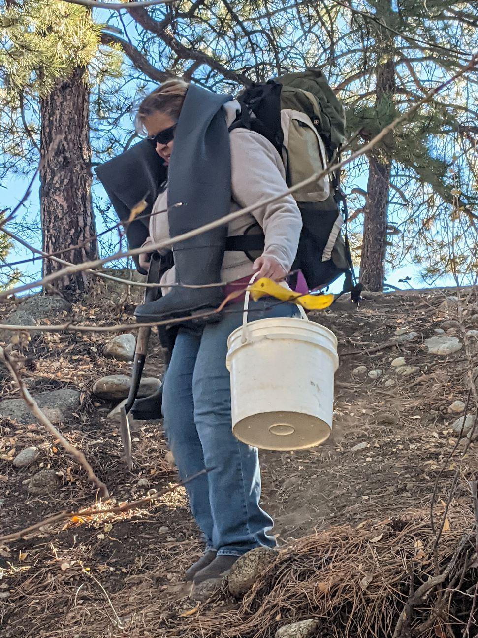
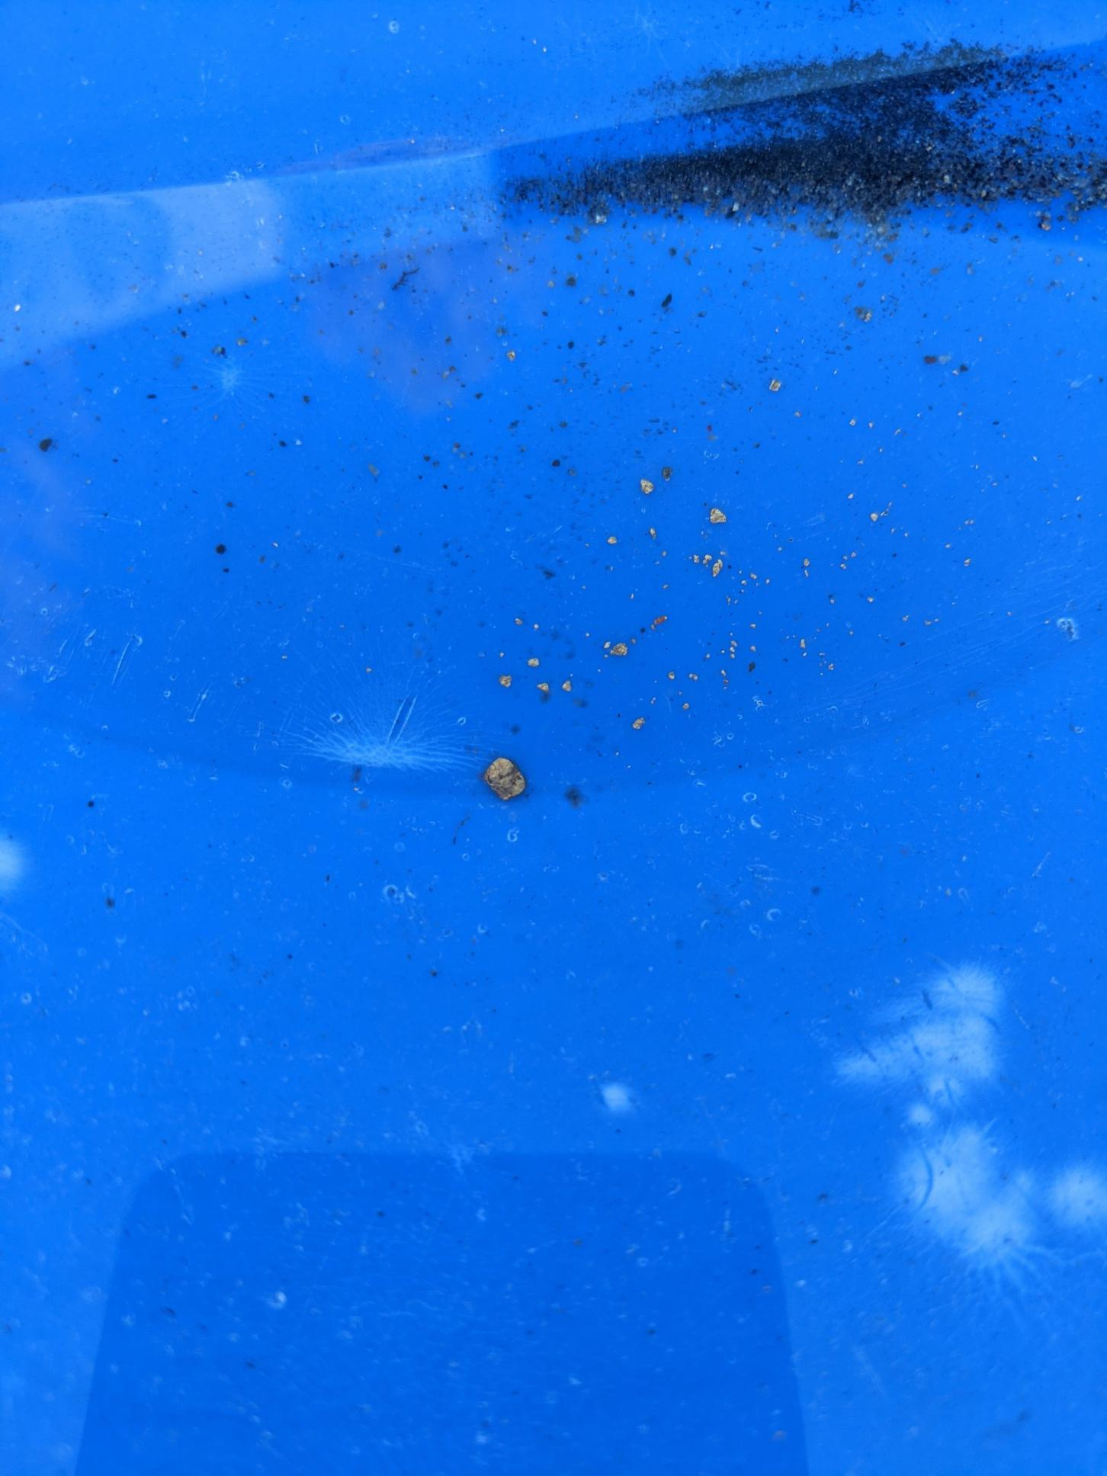
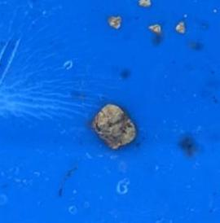
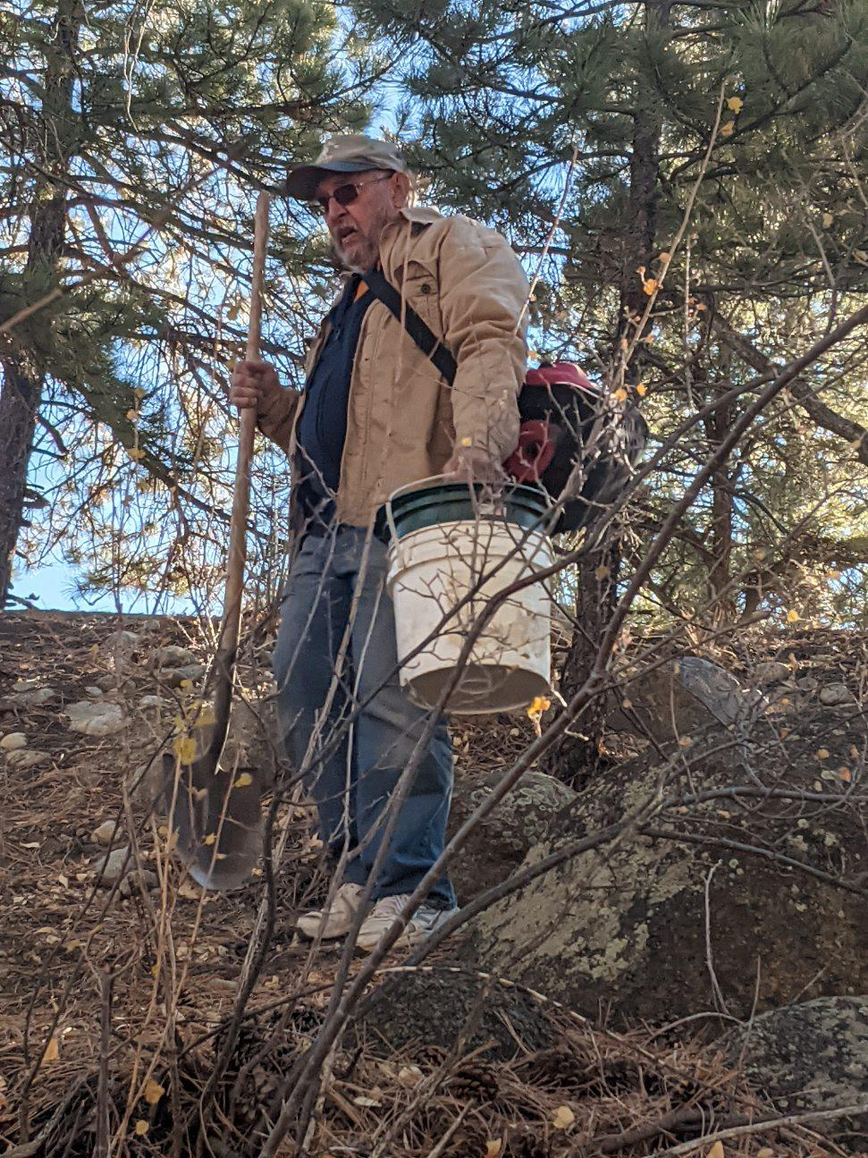
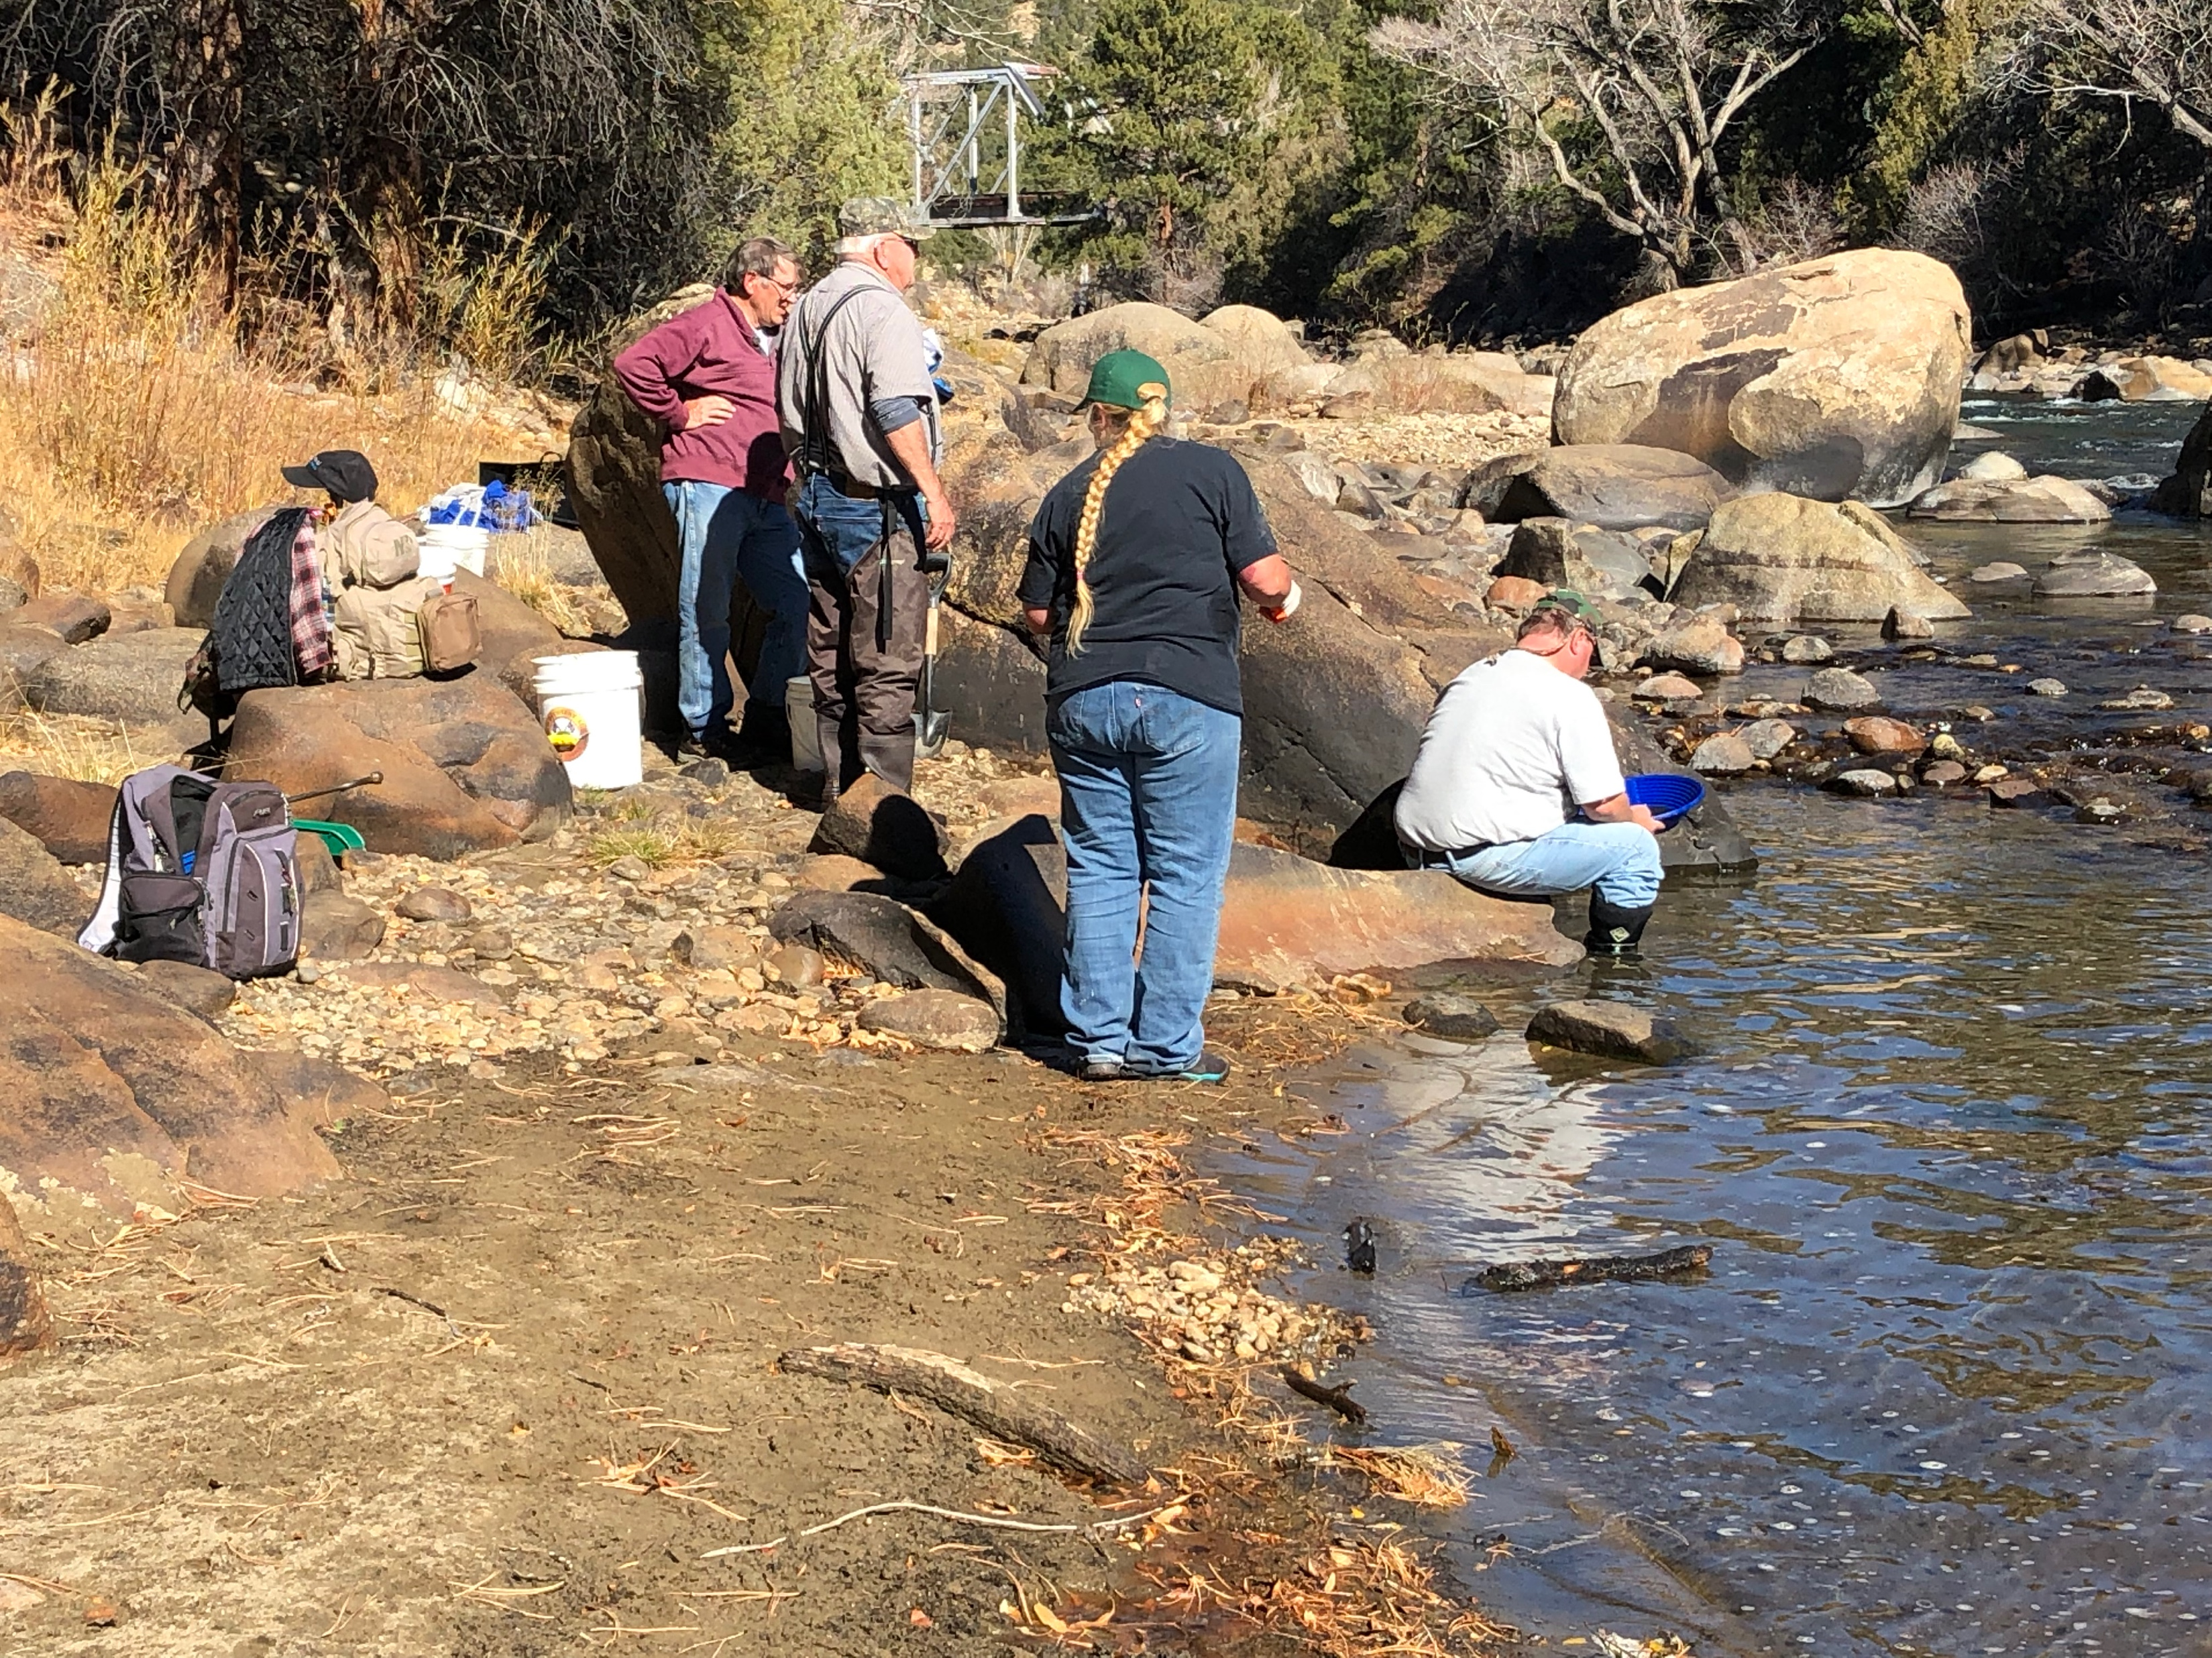
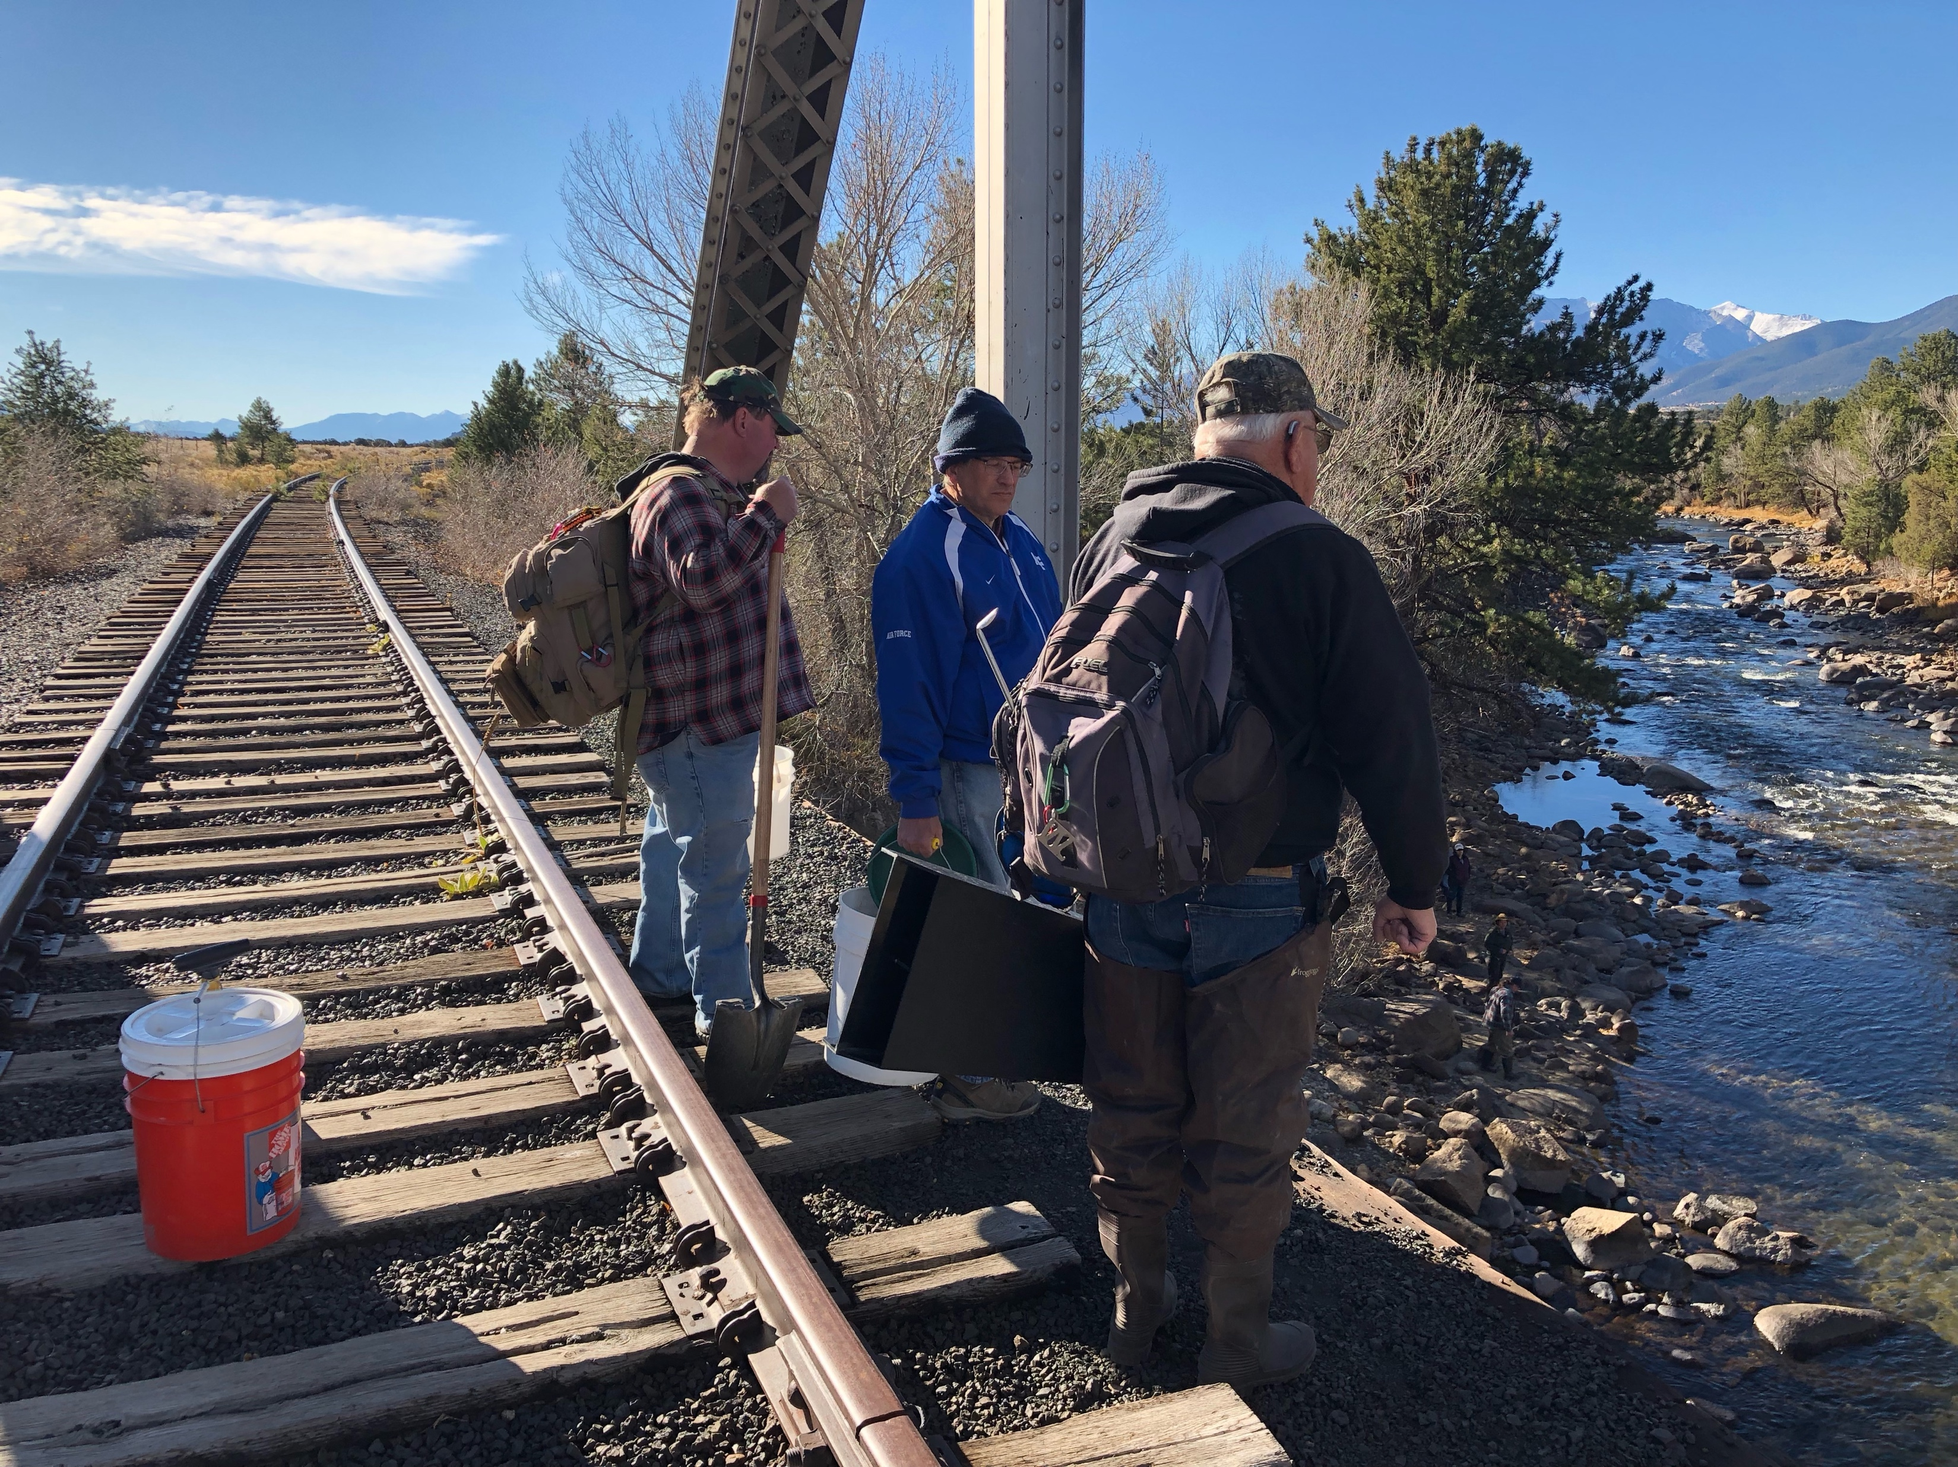
GPAA
COLORADO SPRINGS CHAPTER
OUTINGS AND EVENTS
30 November 2021
Railroad Bridge site Buena Vista CO.
Photos courtesy John Michler who was the winner with the large picker in the center photo.

Slide 8
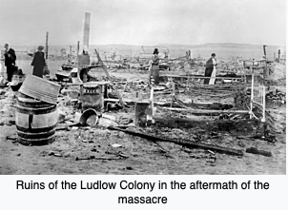

2021, 14 September - 18 December
The massacre of striking miners and their families at Ludlow, Colorado, on April 20, 1914, made newspaper headlines worldwide. Coal miners had gone on strike in September 1913 to protest unsafe working conditions, long hours and low pay, and non-compliance with state mining laws by several coal mining companies, including Colorado Fuel & Iron and Victor American Fuel Company. Miners and their families established a number of tent colonies; Ludlow was located twelve miles northwest of Trinidad. Gunfire between strikers and state militia troops took place on April 20 and resulted in more than twenty deaths. The camp was overrun and burned by the troops. In the long run, the terrible calamity at Ludlow led to federal and state legislation designed to address the complaints of miners against their employers.
This exhibit is curated by the Department of Anthropology at the University of Colorado, Colorado Springs. With the permission of the United Mine Workers of America, the UCCS department, and in conjunction two other universities, they performed archaeological digs at Ludlow that helped to answer a number of questions about the site. Using storyboards, artifacts from the camp found by the department students and professors, and artifacts from the museum’s collections, Killing for Coal tells the Ludlow story.
Thank you to Dr Karin Larkin , Assistant Professor and Curator of Anthropology at UCCS. who opened our exhibit with a fascinating lecture. Her students, (Spring Semester 2021), wrote the text for this exhibit and assembled the images and artifacts, with assistance from staff at WMMI. The exhibit will close December 18, 2021.
The Killing for Coal special exhibit is publicly accessible during the museum’s normal business hours of 9am-4pm Monday-Saturday. Regular museum admission rates apply.
Photo is available from the United States Library of Congress Prints and Photographs division under digital ID ggbain.15859. Public Domain File: Ruins of Ludlow restored. created 1 January 1914

Slide 9
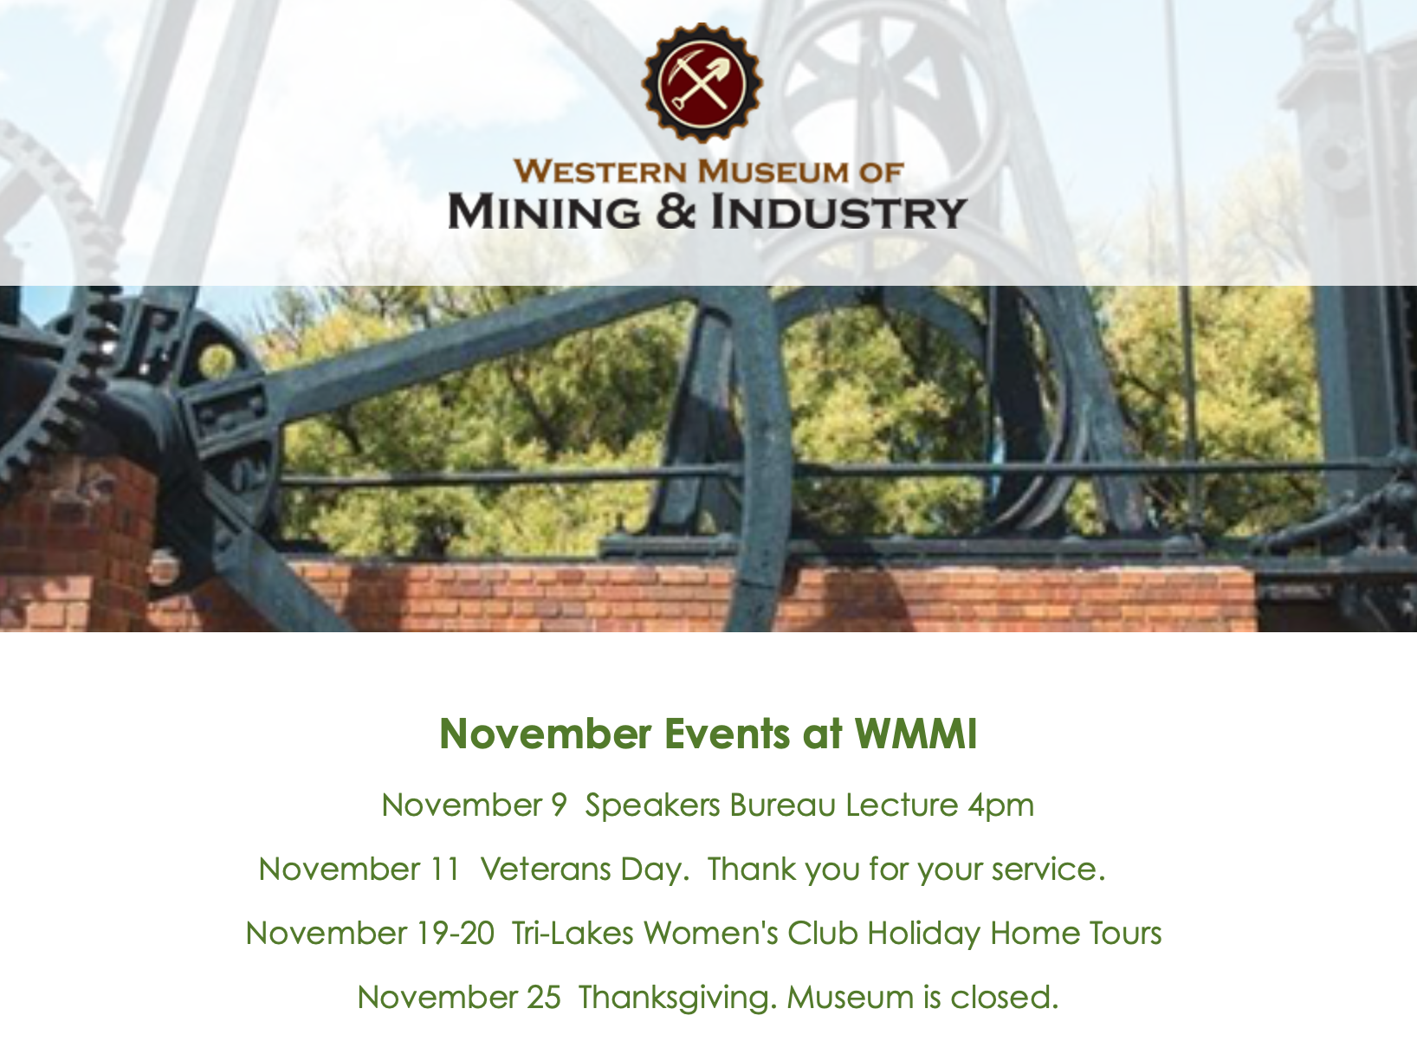

Slide 10
GPAA
Colorado Springs Chapter Links
Sunny Mountain Prospectors LLC
3007 North El Paso Street
Colorado Springs, Colorado 80907
(719)722-3998
https://sunnymountain.net
Let’s support our local prospecting business.
Gold Prospectors of Colorado
https://gpoc.club
(20+) Gold Prospectors of Colorado | Groups | Facebook
Meeting location has changed to:
American Legion Post 38
6685 Southmoor Dr,
Fountain, CO 80817
The Rock Doc
http://www.therockdoc.net
Public Lands for the People
https://www.publiclandsforthepeople.org
Public Lands For The People
PO Box 1660
Inyokern, CA 93527
1-844-757-1990
Western Museum of Mining and Industry
https://wmmi.org
Prospecting Equipment for Sale
If you have any prospecting equipment for sale or trade please email me at coxd@mac.com

